Slide 1
Factors Affecting Survival in the Titanic Disaster

Slide 2
Context
The sinking of the RMS Titanic in 1912 remains one of the deadliest peacetime maritime disasters
1502 passengers onboard, only 706 survivors
Lack of lifeboats for all passengers was a major factor
But what personal factors influenced odds of survival?

Slide 3
Problem
Objective: Uncover and analyze factors that affected passenger survival rates in the Titanic disaster
Could inform policies to improve coordination and survival in potential future disasters

Slide 4
Hypotheses
Hypothesis 1: Passenger class correlated with survival odds
Hypothesis 2: Women and children had higher survival rates
Hypothesis 3: Younger passengers had higher survival odds

Slide 5
Hypothesis #1
No difference in survival rate between passenger classes
Use 2 sample t-test to compare survival rate between 2 passenger classes e.g. 1st class vs 2nd class
Null hypothesis: There is no difference in mean survival rate between the two classes
Alternate hypothesis: There is a significant difference in survival rate between the two classes
Check p-value - if p-value < significance level (say 0.05), we can reject the null hypothesis

Slide 6
Hypothesis #2
No difference in survival rate between males and females
Use 2 sample t-test to compare survival rate between males and females
Null hypothesis: There is no difference in mean survival rate between males and females
Alternate hypothesis: There is a significant difference in survival rate between males and females
Check p-value - if p-value < significance level (say 0.05), we can reject the null hypothesis

Slide 7
Hypothesis #3
No correlation between age and survival rate
Use tukey test between age and survival
Null hypothesis: There is no correlation between age and survival
Alternate hypothesis: There is a significant correlation between age and survival

Slide 8
Analysis Approach
Performed exploratory analysis on Titanic dataset
Conducted statistical tests like t-tests, pairwise_tukeyhsd, confidence interval
Created visualizations using matplotlib.pyplot
Analyzed survival rates across passenger segments

Slide 9
Hypothesis #1 - Passenger class correlated with survival odds

Slide 10
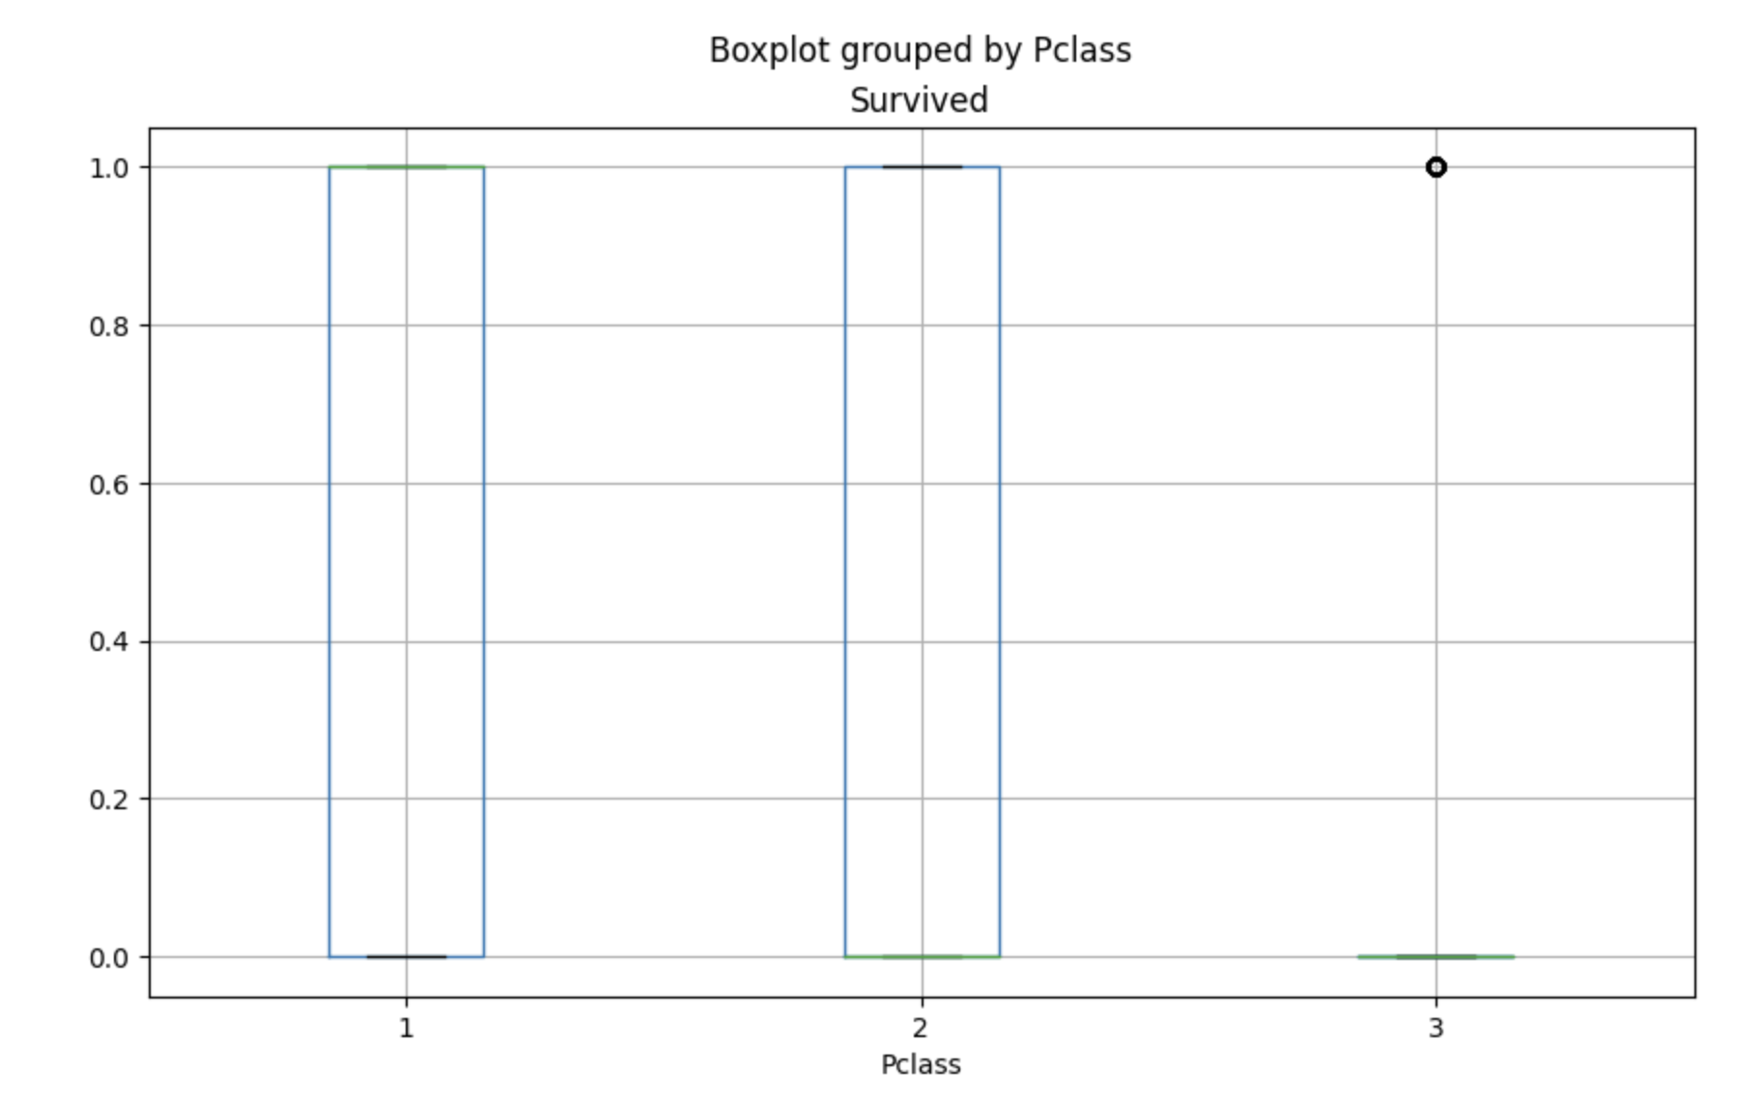
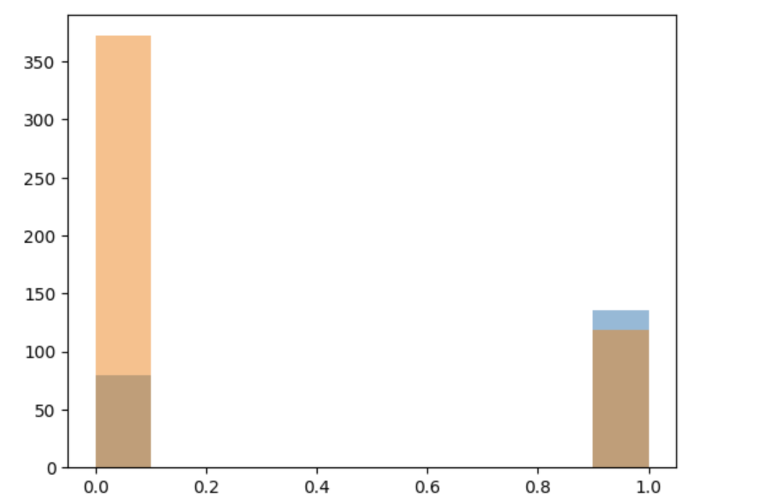
Passenger Class
Chart showing survival rate by passenger class
Findings: Survival rate decreased from 1st to 3rd class
Likely upper class passengers given preference

Slide 11
Passenger Class - Confidence Interval
Result:
get_95_ci(class1['Survived'], class3['Survived'])
The difference in means at the 95% confidence interval (two-tail) is between -0.4621425411527275 and -0.3123916671900349.
With 95% confidence, passengers with class1 have 31 to 46% more chance of survival when compared to class3 passengers.

Slide 12
Passenger Class - Hypothesis
Result:
stats.kruskal(class1['Survived'],class3['Survived’])
KruskalResult(statistic=97.42772131514926, pvalue=5.585850215021343e-23)
Since the p-value < significance level ( 0.05), we can reject the null hypothesis, hence it proves that there is a significant difference in survival rate between the two classes.

Slide 13
Hypothesis #2 - Women and children had higher survival rates

Slide 14
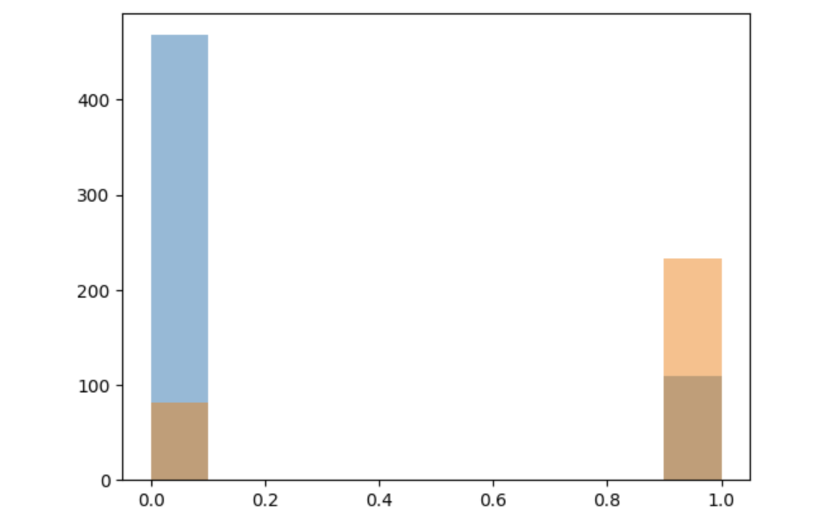
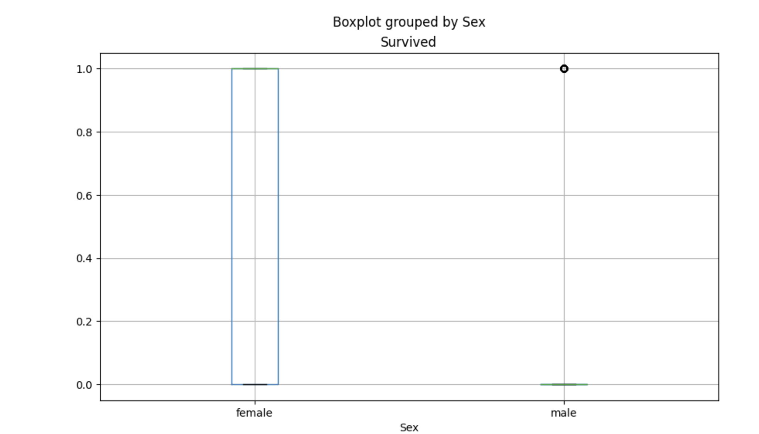
Passenger’s Gender
Chart showing survival rate by gender
Findings: Women had much higher survival than men
"Women and children first" protocol followed

Slide 15
Passenger’s Gender – Confidence Interval
Result
get_95_ci(female['Survived'], male['Survived’])
The difference in means at the 95% confidence interval (two-tail) is between -0.6111926580236517 and -0.4950674839361888.
with 95% confidence, female passengershave 50 to 61% more chance of survival when compared to male passengers.

Slide 16
Passenger’s Gender – Hypothesis
Result
stats.kruskal( male['Survived'], female['Survived’])
KruskalResult(statistic=262.75534334779314, pvalue=4.304562532204558e-59)
Since the p-value < significance level ( 0.05), we can reject the null hypothesis, hence it proves that there is a significant difference in survival rate between males and females.

Slide 17
Hypothesis #3 - Younger passengers had higher survival odds

Slide 18
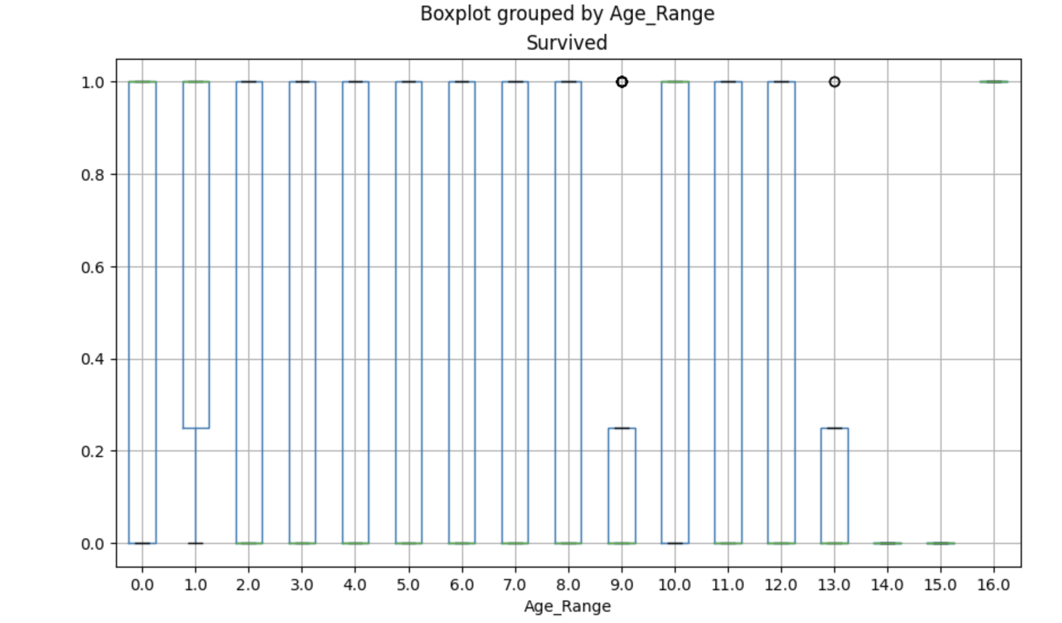
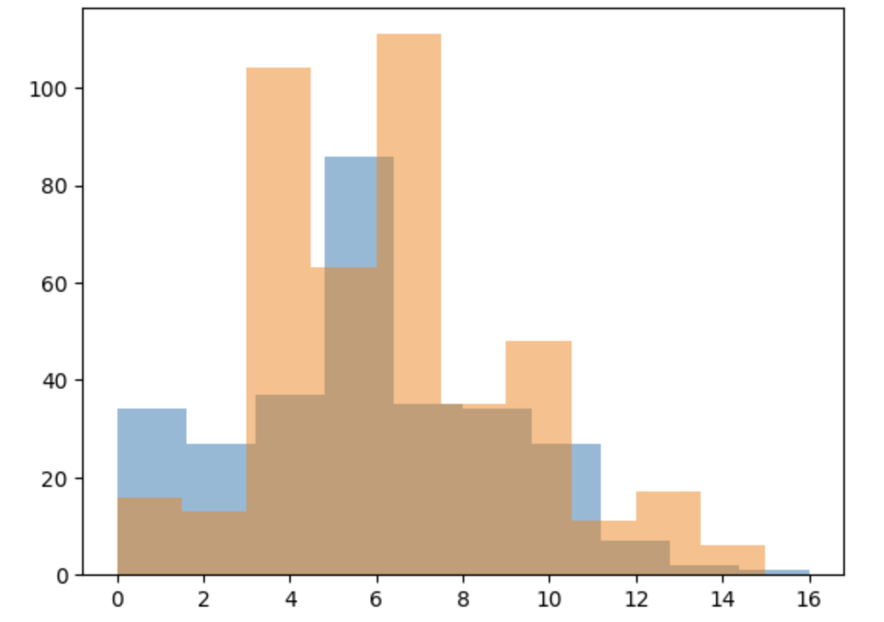
Passenger’s Age
Chart showing survival across age groups
Findings: Survival higher for younger passengers
Elderly passengers had low survival

Slide 19
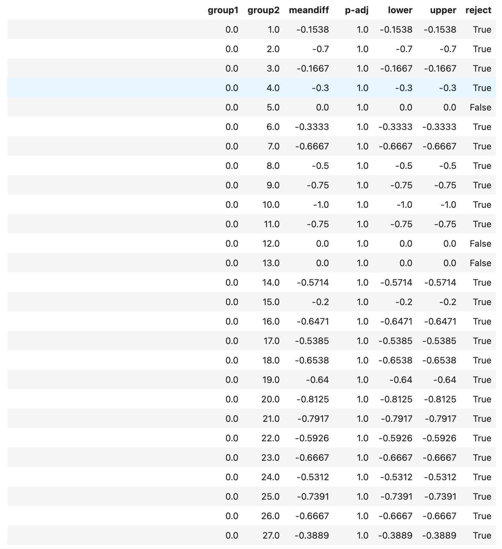
Passenger’s Age – Hypothesis
Result
tukey = pairwise_tukeyhsd(endog = tdf['Survived'], # Data groups = tdf['Age_Round'], # Groups alpha=1.0)
The tukey stats analysis output will show the mean differences between age groups, the confidence interval, and whether the null hypothesis is rejected for each pair.
Per the output, the pair with lesser age, the tukey stats analysis reports that null hypothesis can be rejected, hence the hypothesis, there is a significant correlation between age and survival, is true.

Slide 20
Recommendations
Proportional lifeboats across classes
Priority for children regardless of class
Alert systems accessible to all passengers

Slide 21
Summary
Key findings: Class, gender, age correlated with survival
Recommendations can improve coordination and survival
"We cannot change the past, but we can learn from it"

Slide 22
Passenger’s Age - Hypothesis

